Slide 1
raytracing
Neeraj surjaye

Slide 2
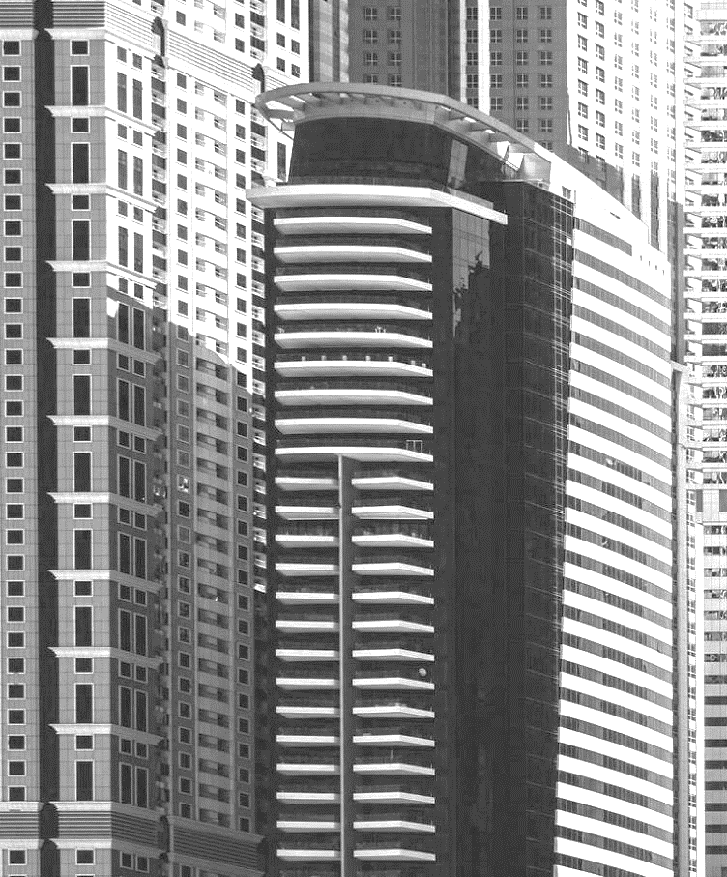
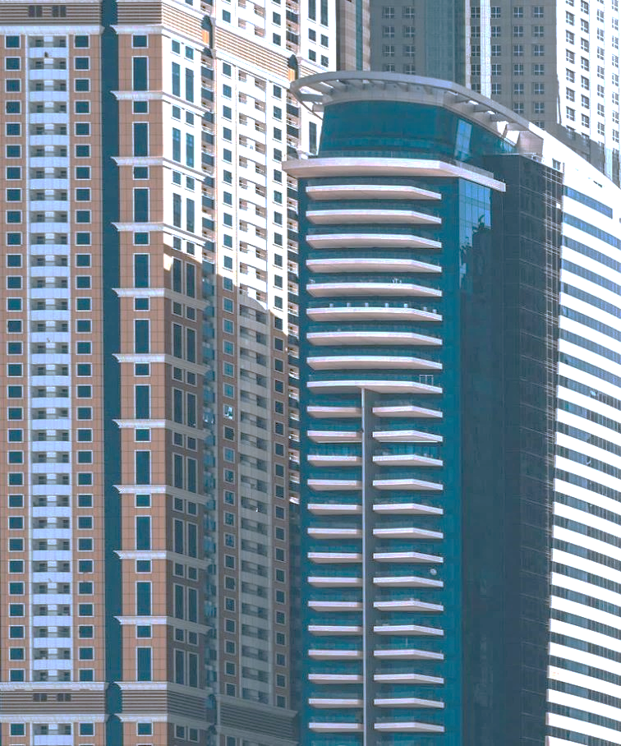
AGENDA
Computer Graphics
Rasterization
Raytracing
Project

Slide 3

Computer Graphics
Refers to the creation, manipulation, and rendering of images using computers. It encompasses a wide range of techniques and technologies aimed at generating visual content, including 2D and 3D images, animations, and graphical user interfaces (GUIs). Computer graphics are utilized in various fields such as entertainment, design, simulation, virtual reality, scientific visualization, and more.

Slide 4
Rasterization

Slide 5
Rasterization
In the context of 3D graphics, rasterization is used to draw 3D models. It computes the mapping from scene geometry to pixels but does not prescribe a particular way to compute the color of those pixels. The specific color of each pixel is assigned by a pixel shader.
Compared with other rendering techniques such as ray tracing, rasterization is extremely fast and therefore used in most real-time 3D engines. However, the results may not be as realistic as what ray tracing can achieve

Slide 6
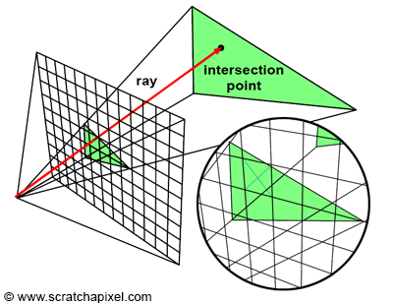
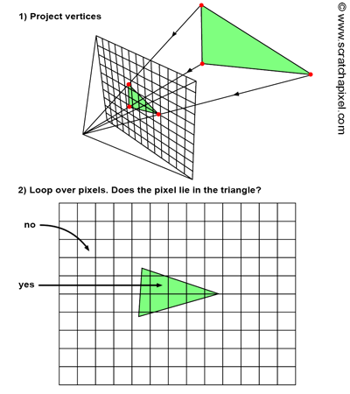
How rasterization works

Slide 7
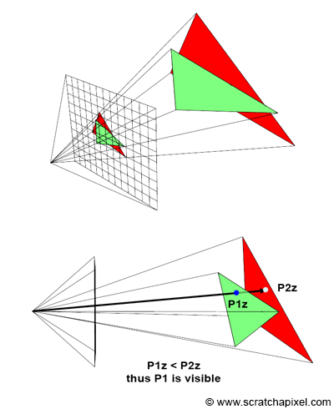
Checking Depth
A z-buffer is essentially another two-dimensional array, matching the image's dimensions. Unlike the array of colors, it consists of floating-point numbers. Before rendering begins, each pixel in this array is initialized to a very large number. When a pixel overlaps a triangle, we also check the value in the z-buffer at that pixel's location.

Slide 8
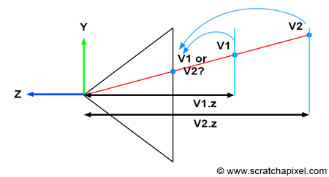
Which pixel to render?

Slide 9
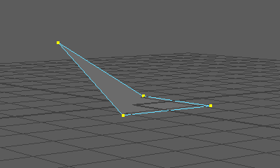
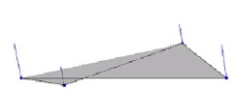
Why Triangles?
Triangles are always planar. Any polygon with more than three points can be non-planar and thus un-renderable unless converted to triangles. It takes a lot of calculations to make sure all the points are co-planar, thus all polygons that are greater than three points are pre-calculated by decimating them into triangles

Slide 10
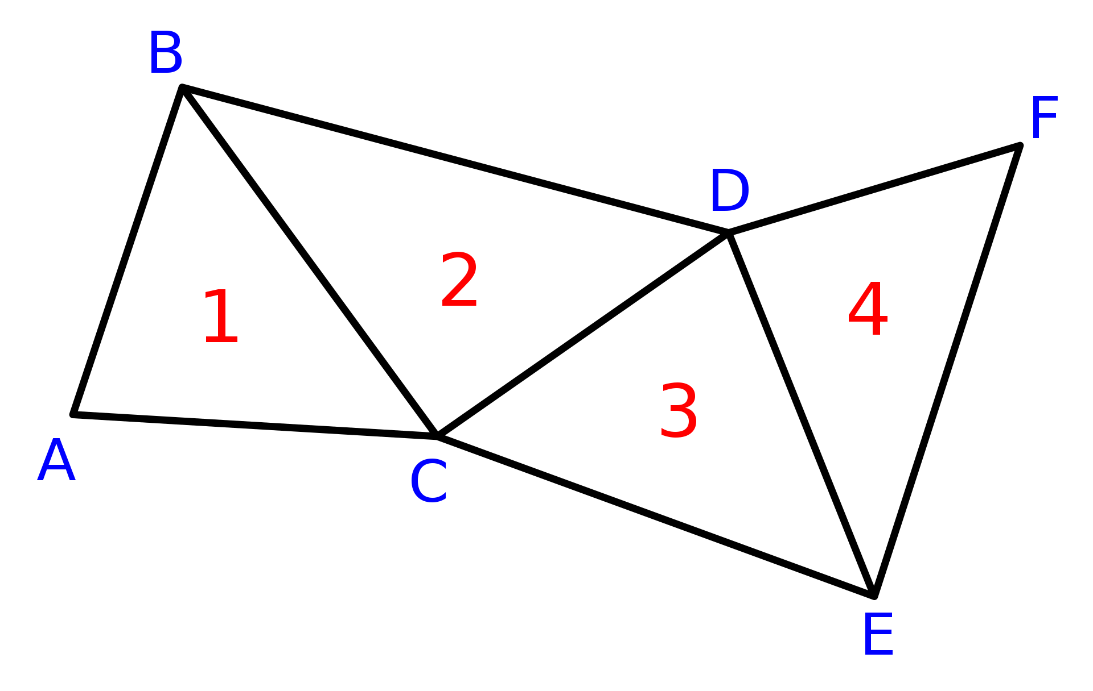
Why Triangles?
Triangles also are very memory efficient and can be sorted, and rendered extremely fast when using Triangle Strips which only need 1 point to be stored for each additional triangle after the first.

Slide 11
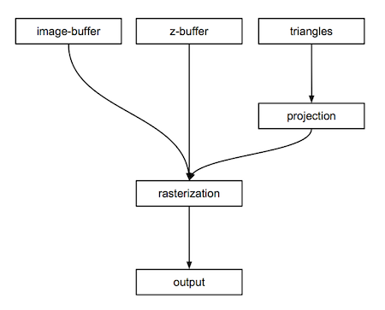
Overview

Slide 12
Raytracing

Slide 13
RAYTRACING
Ray tracing is a rendering technique that can produce incredibly realistic lighting effects. Essentially, an algorithm can trace the path of light, and then simulate the way that the light interacts with the virtual objects it ultimately hits in the computer-generated world

Slide 14
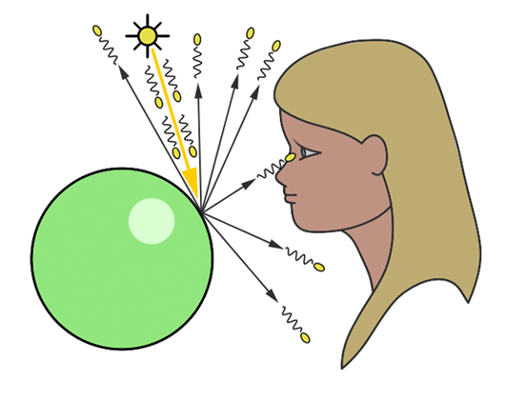
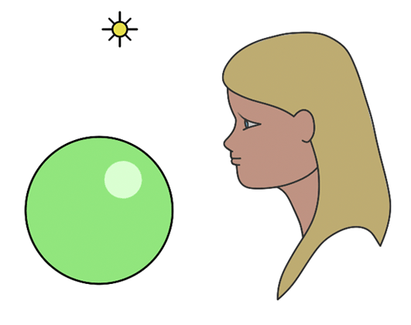
Foreword Tracing and reverse Tracing

Slide 15
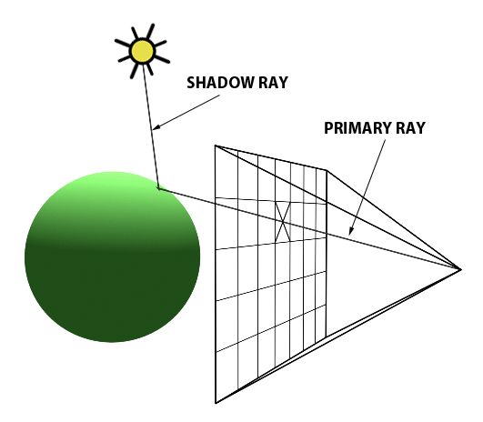
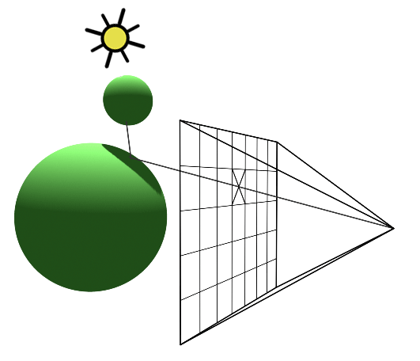
Raytracing

Slide 16
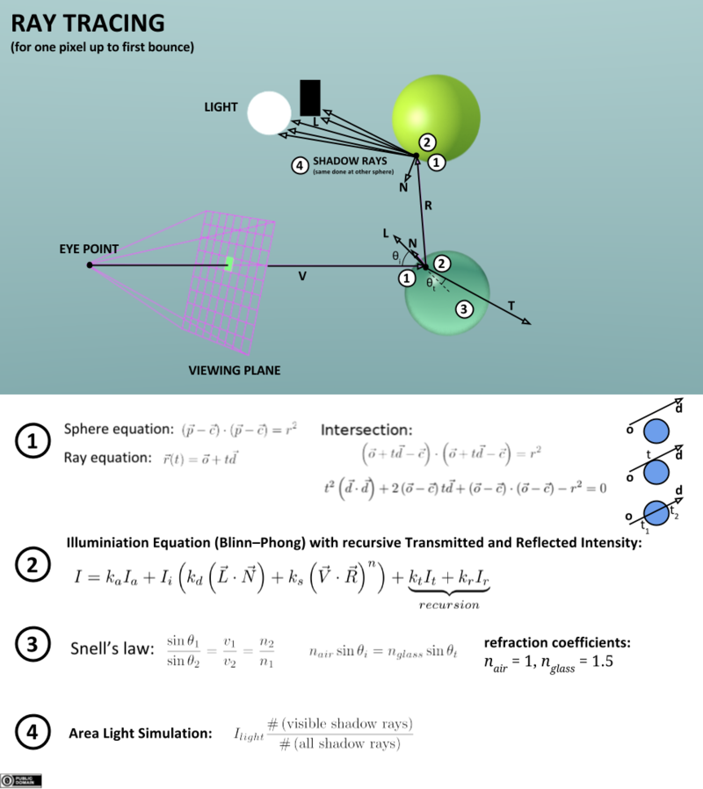
PathTracing

Slide 17
PathTracing

Slide 18
Raytracing Project
SPRT
https://github.com/neerajsurjaye/SPRT

Slide 19
THANK YOU

